Slide 1
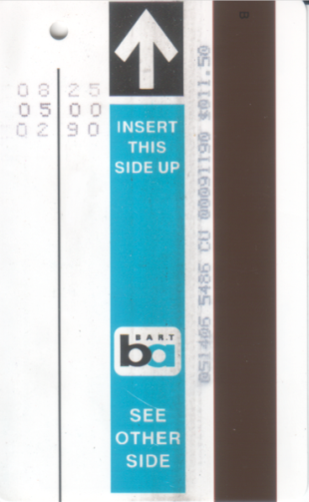
Mileage-Based Transit Fares
Timothy Sweetser, FCAS
Bay Area R Users Group
October 2, 2013

Slide 2
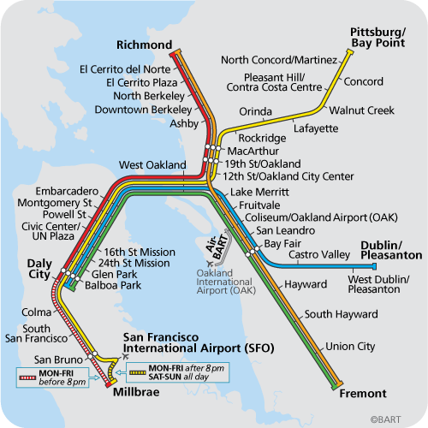
Bay Area Rapid Transit (BART)
Opened in 1972
Serves counties of San Francisco, Alameda, Contra Costa, and Northern part of San Mateo
Does NOT serve counties of Santa Clara, Marin, or the rest of San Mateo
you are here
Notes:
My commute is Rockridge – Pleasant Hill/Contra Costa Centre

Slide 3
Bay Area Rapid Transit (BART)
“BART fares are set with a mileage-based formula, therefore time-based passes (e.g., weekly or monthly) are not available.”
http://bart.gov/tickets/index.aspx

Slide 4
Bay Area Rapid Transit (BART)
“BART fares are set with a mileage-based formula, therefore time-based passes (e.g., weekly or monthly) are not available.”
http://bart.gov/tickets/index.aspx
Let’s figure out the formula! For every trip, we need
The fare
Miles traveled

Slide 5
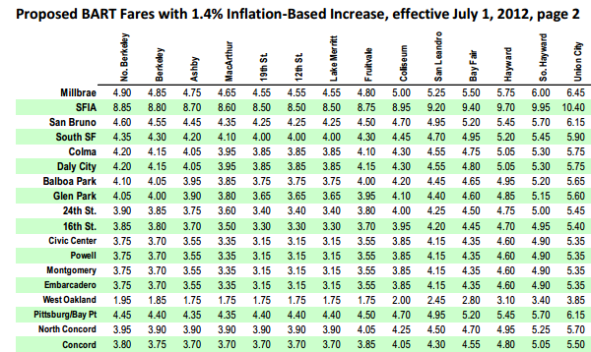
1. BART’s Fare Table
This is an excerpt from http://www.bart.gov/docs/community_meetings/March_2012/1.4_fare%20table.pdf
Notes:
Highlight Millbrae – North Berkeley [1, 1]. $4.90

Slide 6
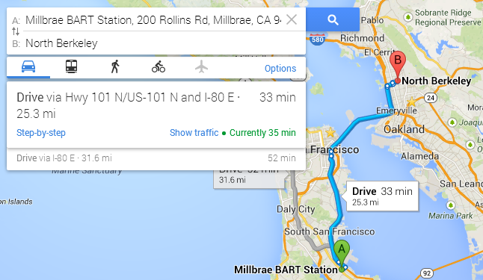
2. Google Maps Driving Directions
Notes:
Proxy for miles traveled on BART
Transbay tube ~ Bay Bridge

Slide 7
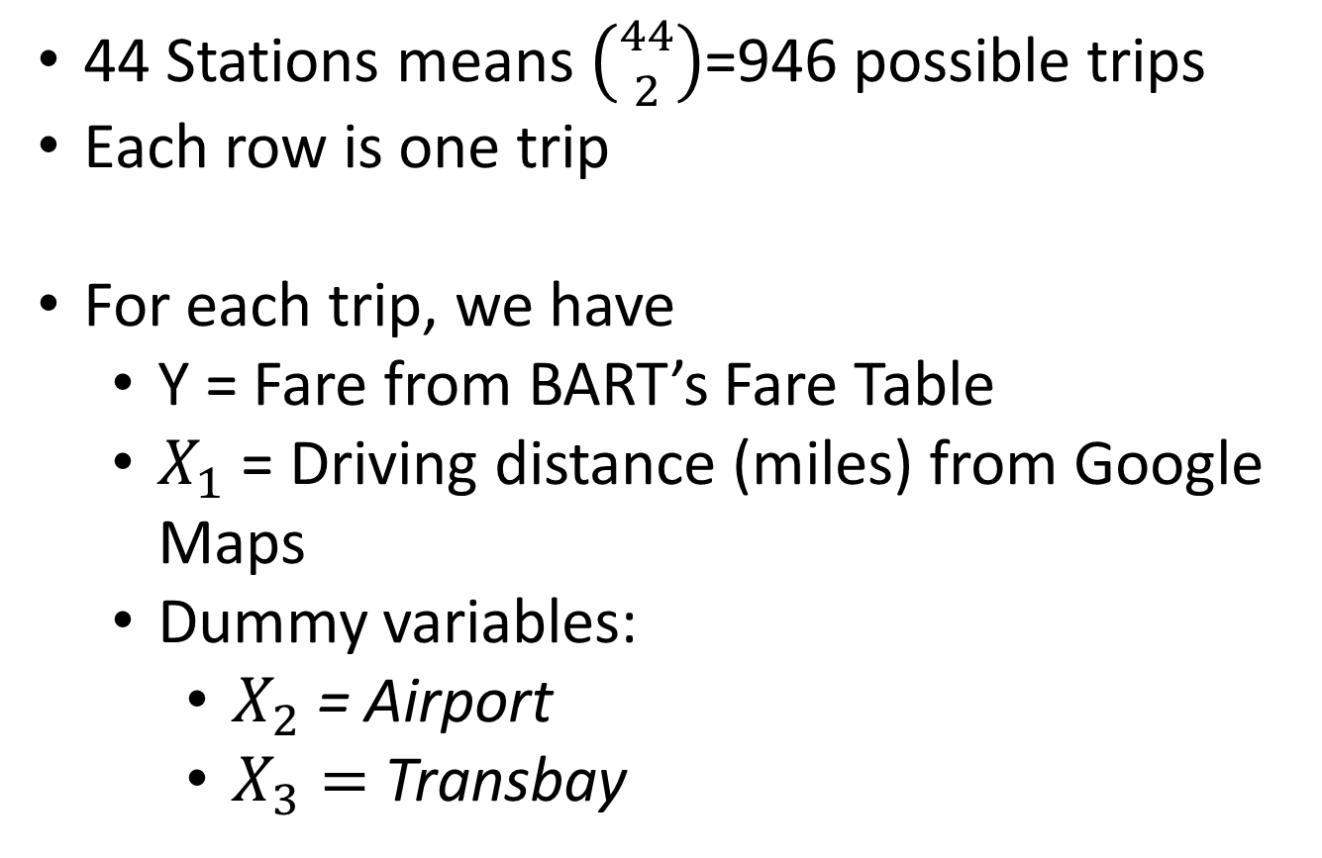
Dataset
44 Stations means $\left({44 \atop 2}\right)$=946 possible trips
Each row is one trip
For each trip, we have
Y = Fare from BART’s Fare Table
$X_{1}$ = Driving distance (miles) from Google Maps
Dummy variables:
$X_{2}$= Airport
$X_{3}=$Transbay

Slide 8
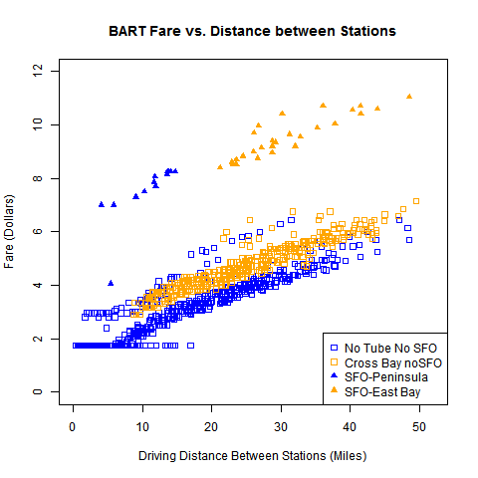
Notes:
Blue = no transbay tube. Orange = transbay
Square = non-airport (lower half). Triangle = airport (upper half)

Slide 9
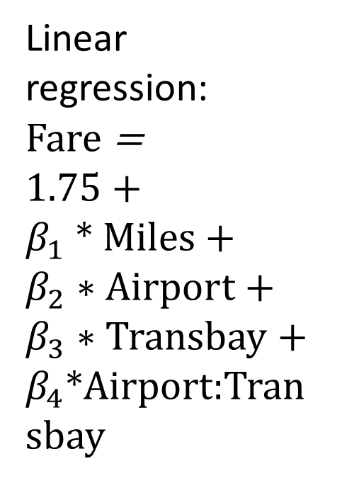
Linear regression:
Fare =
1.75 +
$β_{1}$ * Miles + $β_{2}∗Airport$ +
$β_{3}∗$ Transbay +
$β_{4}$*Airport:Transbay
Notes:
Blue = no transbay tube. Orange = transbay
Square = non-airport (lower half). Triangle = airport (upper half)

Slide 10
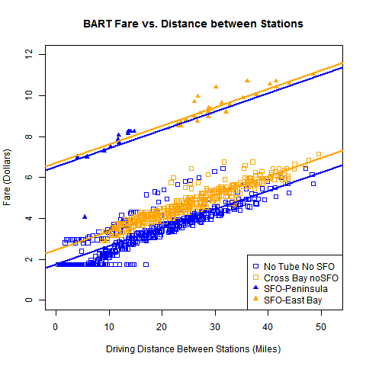
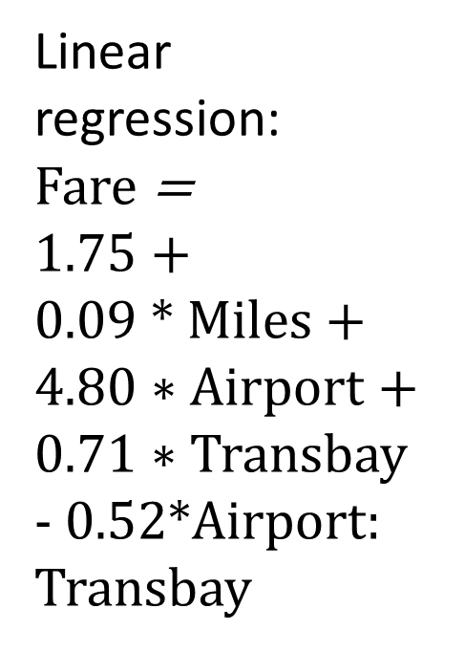
Linear regression:
Fare =
1.75 +
$0.09$ * Miles + $4.80∗Airport$ +
$0.71∗$ Transbay - 0.52*Airport: Transbay
Notes:
Blue = no transbay tube. Orange = transbay
Square = non-airport (lower half). Triangle = airport (upper half)

Slide 11
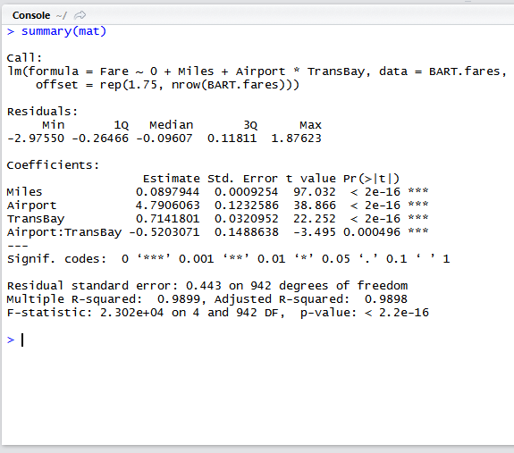
TransBay comes from geocoding each station, and then seeing if the trip begins/ends on different sides of the Bay
Thanks to Statisfaction Blog for the geocode functions
http://statisfaction.wordpress.com/2011/10/05/calling-google-maps-api-from-r/
Notes:
I set 1.75 to be the intercept because I know it’s the minimum fare

Slide 12
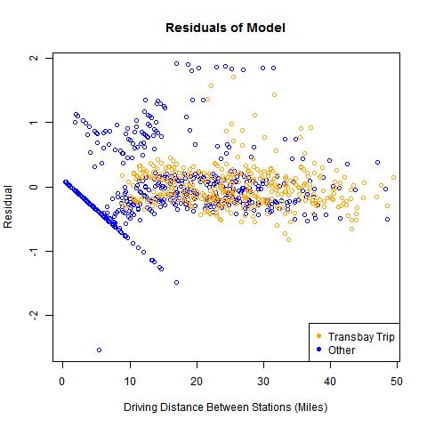
Model Residuals = Actual Fare – Predicted Fare
Residual = Actual - Predicted
Notes:
Problems: Fremont – SFO: driving, you take the San Mateo Bridge, so driving miles are much fewer than BART miles

Slide 13
Linear regression:
Fare =
1.75 +
$0.09$ * Miles + $4.80∗Airport$ +
$0.71∗$ Transbay - 0.52*Airport: Transbay
Notes:
Blue = no transbay tube. Orange = transbay
Square = non-airport (lower half). Triangle = airport (upper half

Slide 14
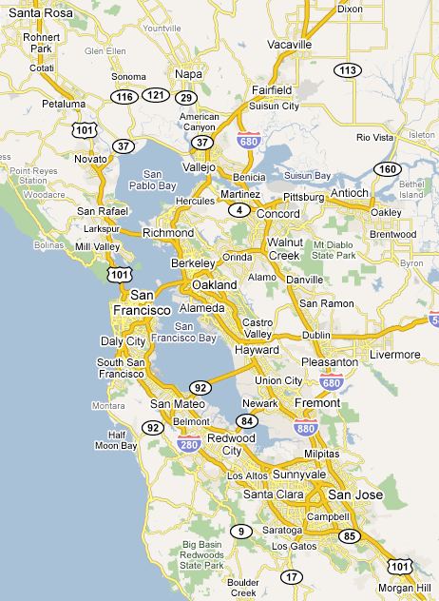
Applications
New Stations
Warm Springs, San Jose, Santa Clara
Pittsburgh, Antioch, Oakley, Brentwood
Livermore
Oakland Airport Connector (2014)
Notes:
Will Oakland Airport Connector have a surcharge?

Slide 15
Applications
New Stations
Warm Springs, San Jose, Santa Clara
Pittsburgh, Antioch, Oakley, Brentwood
Livermore
Oakland Airport Connector (2014)
Comparison of marginal costs: 9 cents per mile vs…
Driving
Other transit systems

Slide 16
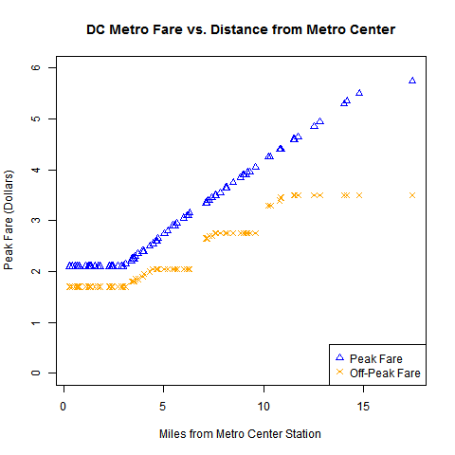
DC Metro System
DC charges higher fares during “peak times”
Miles are provided by Washington Metropolitan Area Transit Authority
Read about it on
https://sites.google.com/site/tsweetser/dc-metro-project
Notes:
See which system offers better value on my website!!!

